Slide 1
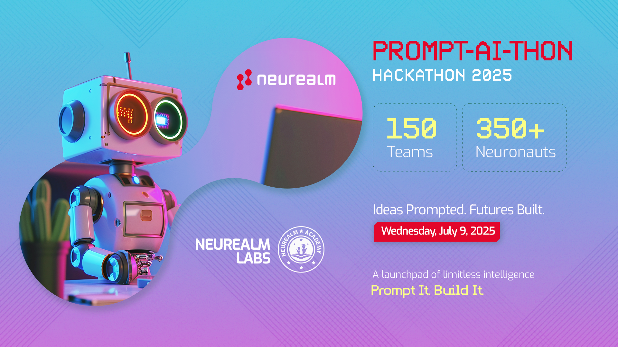

Slide 2
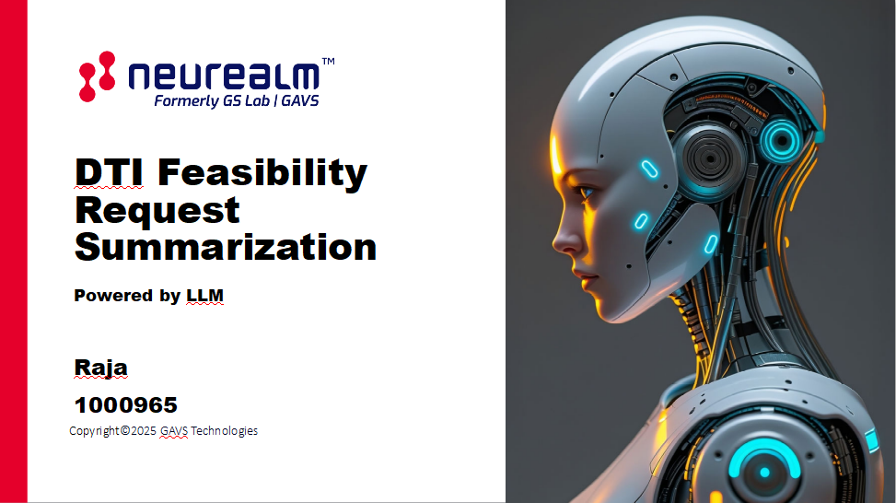

Slide 3
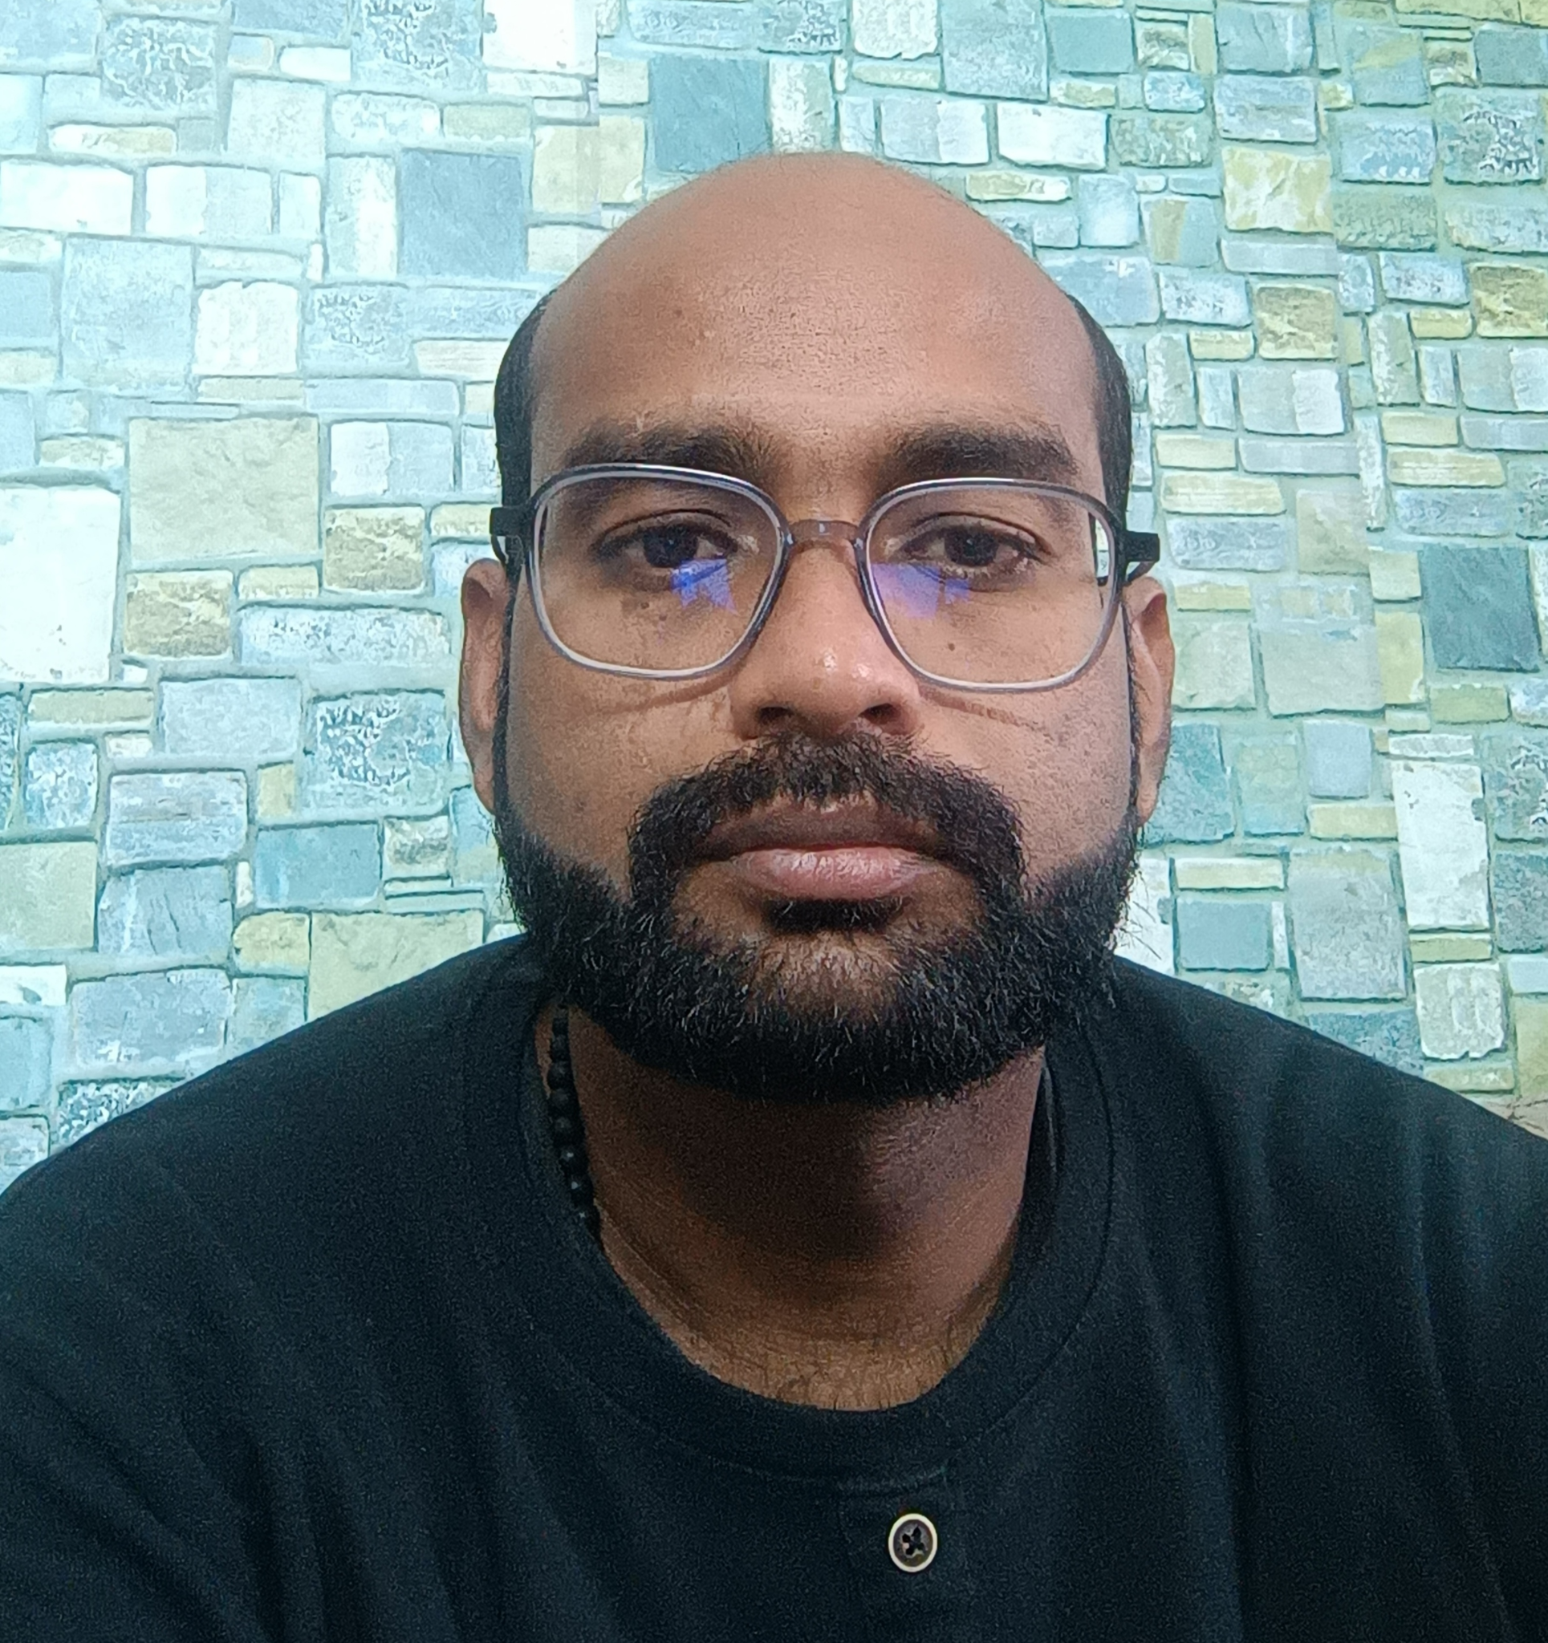
About Me
Dr. D.Raja
M.Pharm
Madurai Medical College
PHD
JSS College of Pharmacy,
Affiliated to JSS University Mysore
Gavs/ Neurealm Exp: >5 years
Position: Principal Research Analyst, Premier Inc
Total Team members: 1 ( Me alone)
Background: Non computer, non technical, non coding

Slide 4
Why this text summarization?
Data, Technology, and Innovation (DTI) Feasibility Form
https://app.smartsheet.com/b/form/4fc7dd36e1a84e67921861bb642b9c69

Slide 5
Often Analyst face
Long paragraphs
Tangled Text
Complex and Confusing writeups
Language barrier
Much time is spent on back and forth communication
Time difference because of time zone

Slide 6
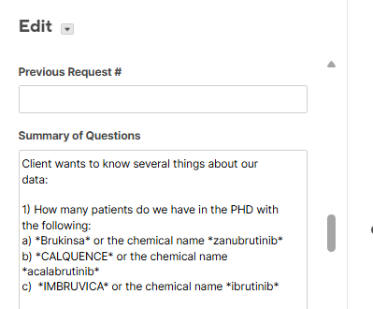
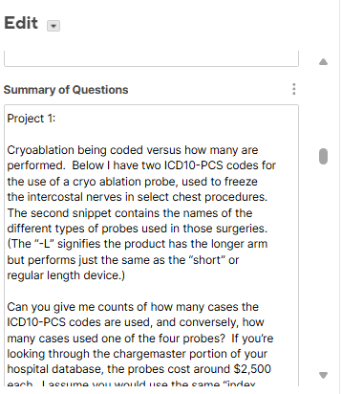
Why this text summarization?
FR3015
FR3032

Slide 7
What is needed?
Summarization tool - Powered by LLM
Untangle the text- uncovering the meaning
From wall of text to window of clarity
Simplify the Complex and clarify the confusing writeups
Less time in reading - More time in analysing

Slide 8
Prompt AI Thon
Hackathon is the perfect time and place to experiment and resolve complex problems

Slide 9
Feasibility Request Simplified
Platform used: Python notebook in Databricks
OpenAI Model : Llama-4-maverick
Parameters: Single-turn task, Few-shot prompting, System and User roles
Max Tokens: 500 -1000
Temperature: 1

Slide 10

FySi

Slide 11
FySi
Demo

Slide 12

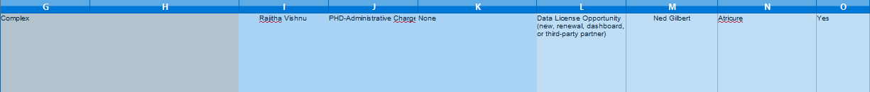
FR3032 original text (as of now what we see)

Slide 13
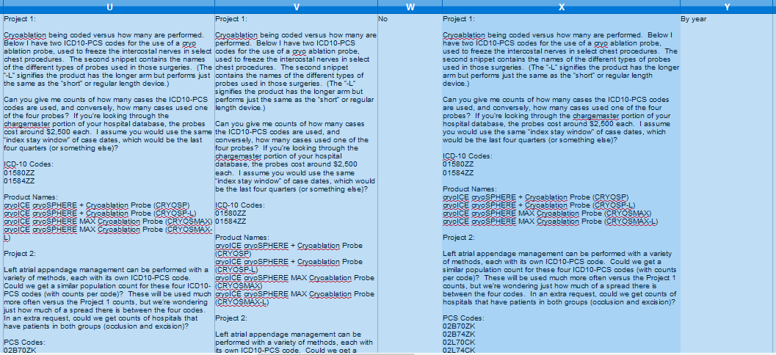
FR3032 original text (as of now what we see)

Slide 14
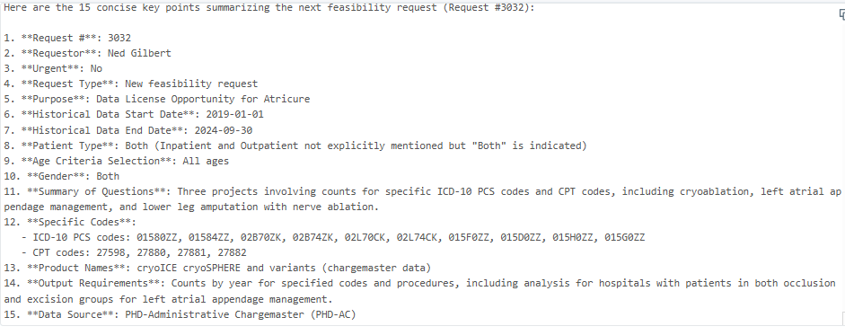
FySi -Output (After text summarization)

Slide 15
FySi -Output (After text summarization)
Pass

Slide 16
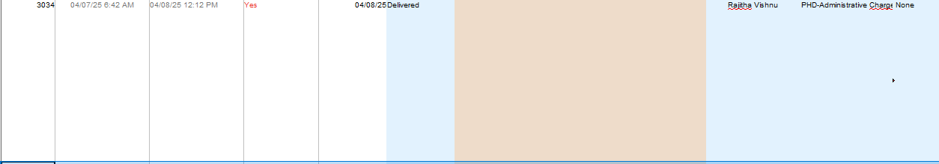
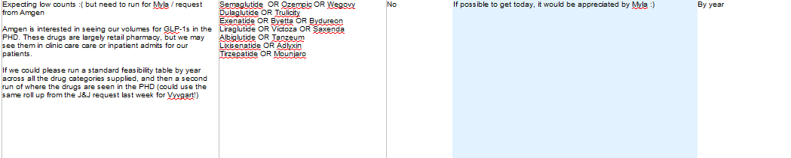
FR3034 original text (as of now what we see)

Slide 17
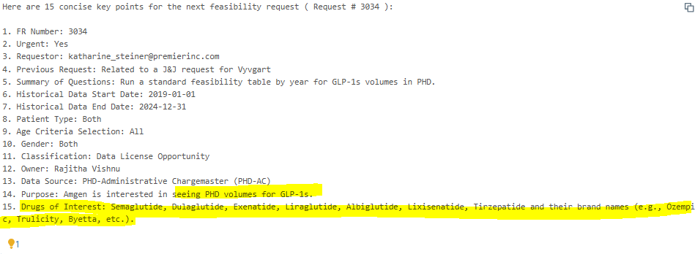
FySi -Output (After text summarization)
Pass

Slide 18
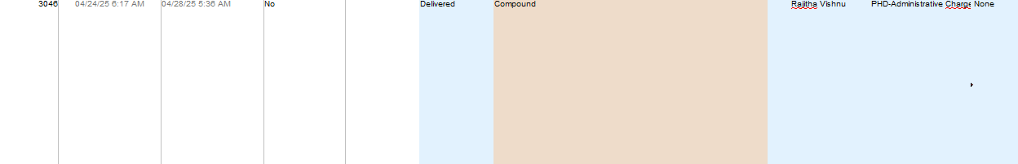
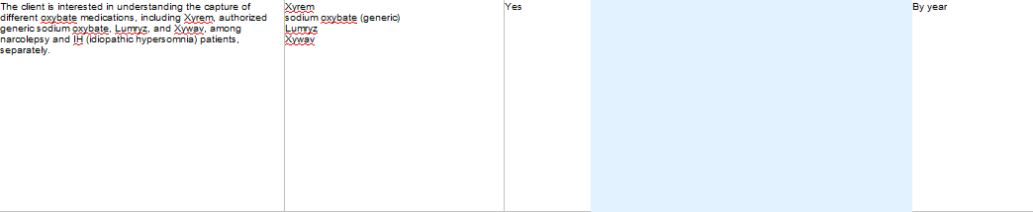
FR3046 original text (as of now what we see)

Slide 19
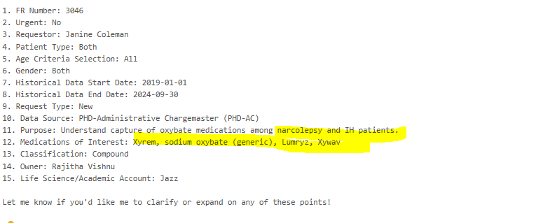
FySi -Output (After text summarization)
Pass

Slide 20
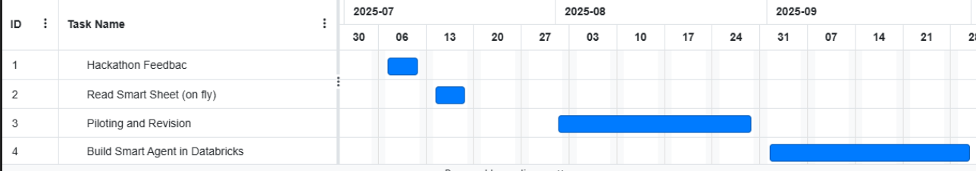
FySi -What Next?
Directly import Smartsheet into databricks
Live FySing
More Robust Testing for one month in real case
Build Smart Agent App in databricks
Gantt Chart

Slide 21

FySi’ ing !
Thanking

